Slide 1
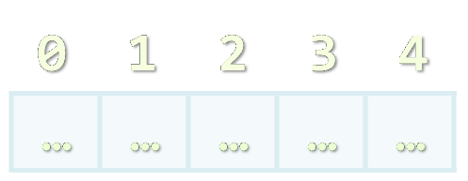





C Arrays
Initializing Arrays, Accessing Elements By Index, Matrices
Programming with C
SoftUni Team
Technical Trainers
Software University
http://softuni.bg

Slide 2

Table of Contents
Declaring and Creating Arrays
Accessing and Modifying Array Elements
Sorting Arrays
Searching Arrays
Multidimensional Arrays

Slide 3


Declaring and Creating Arrays

Slide 4

What are Arrays?
An array is a sequence of elements
All elements are of the same type
The order of the elements is fixed
Has fixed size (must be stored in a separate variable)
Element of an array
0 1 2 3 4
Element index (position)
Array of 5 elements
… | … | … | … | …

Slide 5

Initializing Arrays
An array can be defined in 3 ways:
Stack initialization with specified size
Stack initializer list
int arr[10];
arr[0] = 5;
arr[1] = 2;
int arr[] = { 1, 2, 3 };
printf("%d", arr[0]);

Slide 6
Initializing Arrays (2)
Heap initialization
Allocate 50 * 4 = 200 bytes on the heap
#define SIZE 50
int main()
{
int *arr = malloc(SIZE * sizeof(int));
if (arr != NULL)
{
for (int i = 0; i < SIZE; i++)
arr[i] = i * i;
...
free(arr);
}
}
Free the memory after we're done using it

Slide 7
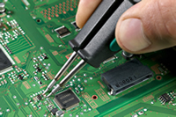
Accessing Array Elements
Read and Modify Elements by Index

Slide 8
Accessing Array Elements by Index
Array elements are accessed
Using the square brackets operator [] (indexer)
Array indexer takes element’s index as parameter
The first element has index 0
The last element has index Length-1
Elements can be retrieved and changed by the [] operator
int arr[] = { 1, 2, 3 };
arr[0] = 10;
arr[1] = arr[2];

Slide 9
Char Arrays
Strings in C are represented as character arrays
Size should be string length + 1
The last character should be reserved for null terminator ('\0')
char name[] = { 'P', 'e', 's', 'h', 'o', '\0' };
0 | 1 | 2 | 3 | 4 | 5
'P' | 'e' | 's' | 'h' | 'o' | '\0'
name
Denotes end of string

Slide 10
Initializing Strings – Example
int main()
{
char firstName[] = "pesho";
firstName[0] = 'P';
char title[4] = "Mr.";
title[3] = '\0';
char *lastName = "Goshov";
printf("%s %s %s\n", title, firstName, lastName);
lastName[0] = 'P'; // Error!
return 0;
}
*lastName resides in read-only memory

Slide 11
String Array
Strings are character arrays
String arrays are arrays of character arrays
int main()
{
char *names[3];
names[0] = "Penka";
names[1] = "John";
names[2] = "Ahmed";
for (int i = 0; i < sizeof(names); i++)
printf("%s\n", names[i]);
return 0;
}

Slide 12
Buffer Overflow
A buffer overflow occurs when the program writes outside the designated memory block, e.g.:
Corrupts adjacent memory blocks
A very serious problem when developing in C
Rule: Always stick to the bounds of the memory you work with
Validate you are not working outside of it
int arr[5];
arr[5] = 10; // Buffer overflow

Slide 13
Accessing Array Elements – Examples
char *towns[] = { "Sofia", "Varna", "Bourgas" };
printf("%d\n", sizeof(towns)); // 24
printf("%s\n", towns[0]); // Sofia
towns[2] = "Pernik";
towns[2][0] = 'G'; // Gernik
// Buffer overflow! Will damage adjacent data
// towns[3] = "Plovdiv";

Slide 14

Accessing Elements By Index
Live Demo

Slide 15
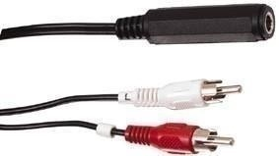
Arrays: Input and Output
Reading and Printing Arrays on the Console

Slide 16
Reading Arrays From the Console
First, read from the console the length of the array
Next, create the array of given size n and read its elements:
int n;
scanf("%d", &n);
int arr[n];
for (int i = 0; i < n; i++)
{
scanf("%d", &arr[i]);
}

Slide 17
Last Digit as String – Example
int main()
{
int n;
scanf("%d", &n);
int lastDigit = n % 10;
char *digits[] = { "zero", "one", "two", "three", "four",
"five", "six", "seven", "eight", "nine" };
printf("%s\n", digits[lastDigit]);
return 0;
}

Slide 18
Printing Arrays
Live Demo

Slide 19
Processing Arrays: for Statement
Use for loop to process an array when
Need to keep track of the index
Processing is not strictly sequential from the first to the last
In the loop body use the element at the loop index (array[index]):
for (int index = 0; index < array.Length; index++)
{
squares[index] = array[index] * array[index];
}

Slide 20
Processing Arrays Using for Loop – Examples
Printing array of integers in reversed order:
Initialize array elements with their index:
int arr[] = { 1, 2, 3, 4, 5 };
int length = sizeof(arr) / sizeof(int);
for (int i = length - 1; i >= 0; i--)
printf("%d ", arr[i]);
// Result: 5 4 3 2 1
for (int index = 0; index < length; index++)
{
arr[index] = index;
}

Slide 21
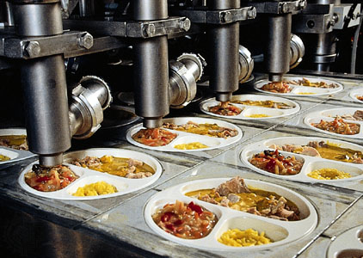
Processing Arrays
Live Demo

Slide 22
Bubble Sort – Example
#include <stdbool.h>
void bubble_sort(int array[], int length)
{
bool hasSwapped = true;
while (hasSwapped)
{
hasSwapped = false;
for (int i = 0; i < length - 1; i++)
{
if (array[i] > array[i + 1])
{
int oldValue = array[i];
array[i] = array[i + 1];
array[i + 1] = oldValue;
hasSwapped = true;
}
}
}
}
Swap values
(example continues)

Slide 23
Bubble Sort – Example
int main()
{
int arr[] = { 5, 3, 8, 7, 3, 2 };
int length = sizeof(arr) / sizeof(int);
bubble_sort(arr, length);
for (int i = 0; i < length; i++)
{
printf("%d ", arr[i]);
}
return 0;
}
More: https://en.wikipedia.org/wiki/Bubble_sort

Slide 24


Bubble Sort
Live Demo

Slide 25
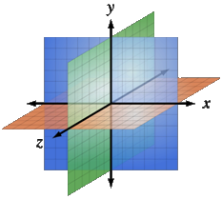
Multidimensional Arrays
Using Array of Arrays, Matrices
and Cubes

Slide 26
What is Multidimensional Array?
Multidimensional arrays have more than one dimension
The most used multidimensional arrays are the 2-dimensional
Known as matrices or tables
Declaring multidimensional arrays:
0 1 2
int intMatrix[3];
float floatMatrix[4][4];
char strCube[3][4][5];
0
1
2
4 | 6 | 3
2 | 1 | 2
6 | 7 | 9
One main array whose elements are arrays

Slide 27
Initializing Multidimensional Arrays
Initializing with values multidimensional array:
Matrices are represented by a list of rows
Rows consist of list of values
The first dimension comes first, the second comes next (inside the first)
int matrix[2][4] =
{
{1, 2, 3, 4}, // row 0 values
{5, 6, 7, 8} // row 1 values
};

Slide 28
Accessing Elements
Accessing N-dimensional array element:
Getting element value example:
Setting element value example:
nDimensionalArray[index₁][...][index_{n}]
int array[3][3];
array[1][1] = 5;
int element11 = array[1][1]; // 5
int array[3][4];
for (int row = 0; row < 3; row++)
for (int col = 0; col < 4; col++)
array[row][col] = row + col;

Slide 29
Reading a Matrix – Example
#define ROWS 2
#define COLS 2
int main()
{
int matrix[ROWS][COLS];
for (int row = 0; row < ROWS; row++)
{
for (int col = 0; col < COLS; col++)
{
scanf("%d", matrix[row][col]);
}
}
return 0;
}

Slide 30
Printing Matrix – Example
int array[ROWS][COLS] = {
{5, 2, 1, 4},
{2, 10, 33, 1},
{7, 6, 3, 0},
{13, 15, 10, 9}
};
for (int row = 0; row < ROWS; row++)
{
for (int col = 0; col < COLS; col++)
{
printf("%-5d", array[row][col]);
}
printf("\n");
}
List initializer

Slide 31

Reading and Printing Matrices
Live Demo

Slide 32
Maximal Platform – Example
Finding maximal sum of 2x2 platform
#include "stdio.h"
#include "limits.h";
#define ROWS 3
#define COLS 6
int main()
{
int matrix[ROWS][COLS] = {
{7, 1, 3, 3, 2, 1},
{1, 3, 9, 8, 5, 6},
{4, 6, 7, 9, 1, 0}
};
int bestSum = INT_MIN;
(example continues)

Slide 33
Maximal Platform – Example (2)
for (int row = 0; row < ROWS - 1; row++)
{
for (int col = 0; col < COLS - 1; col++)
{
int sum = matrix[row][col] + matrix[row][col + 1] +
matrix[row + 1][col] + matrix[row + 1][col + 1];
if (sum > bestSum)
{
bestSum = sum;
}
}
}
printf("%d\n", bestSum);
return 0;
}

Slide 34

Maximal Platform
Live Demo

Slide 35


Matrix Multiplication
Live Demo

Slide 36








C Programming – Arrays
https://softuni.bg/trainings/1212/C-Programming-October-2015

Slide 37
License
This course (slides, examples, demos, videos, homework, etc.) is licensed under the "Creative Commons Attribution-NonCommercial-ShareAlike 4.0 International" license
Attribution: this work may contain portions from
"Programming Basics" course by Software University under CC-BY-SA license

Slide 38






Free Trainings @ Software University
Software University Foundation – softuni.org
Software University – High-Quality Education, Profession and Job for Software Developers
softuni.bg
Software University @ Facebook
facebook.com/SoftwareUniversity
Software University @ YouTube
youtube.com/SoftwareUniversity
Software University Forums – forum.softuni.bg

